Slide 1
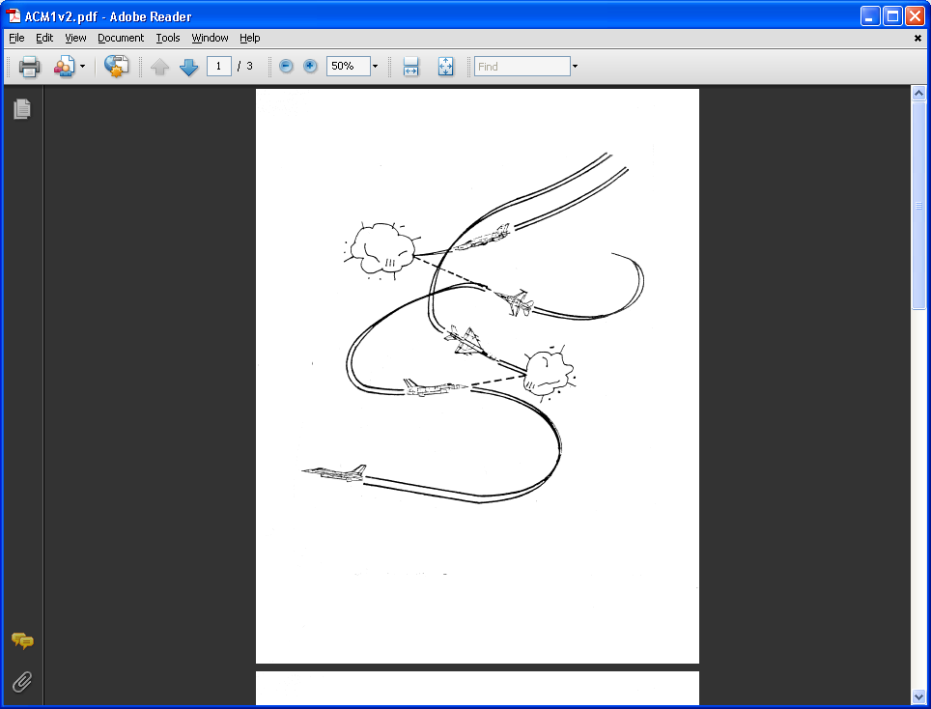
AE 317 Flight Mechanics and Performance
Take-Off and Landing Performance
LECTURE 14
Dr. Jeff Ashworth
Aerospace Engineering Department

Slide 2
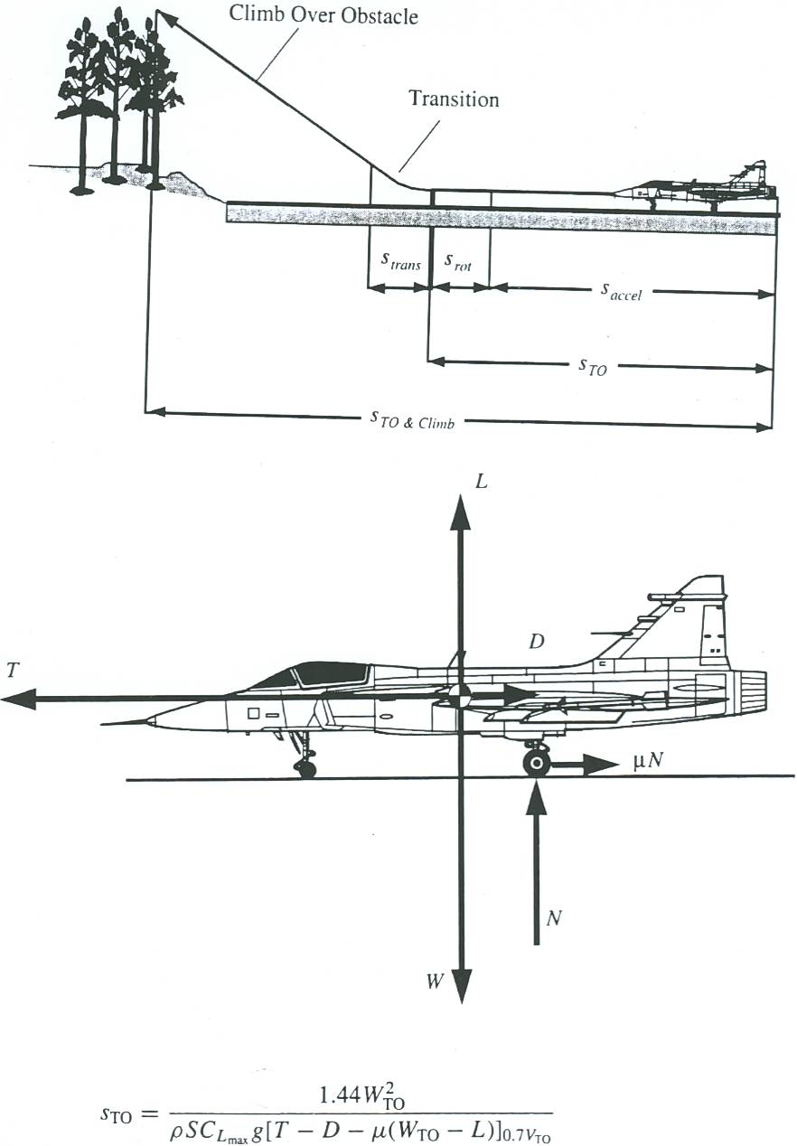
(Brandt)

Slide 3
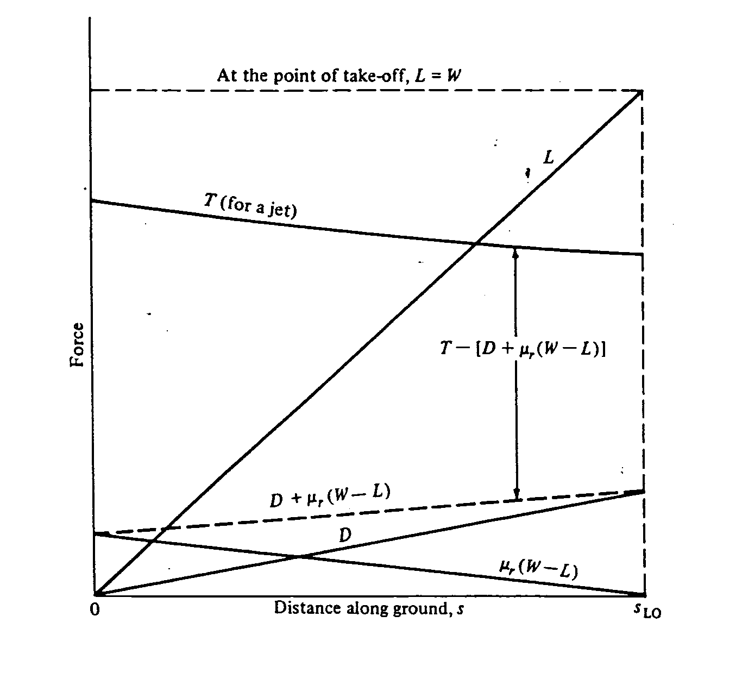
(Anderson)

Slide 4
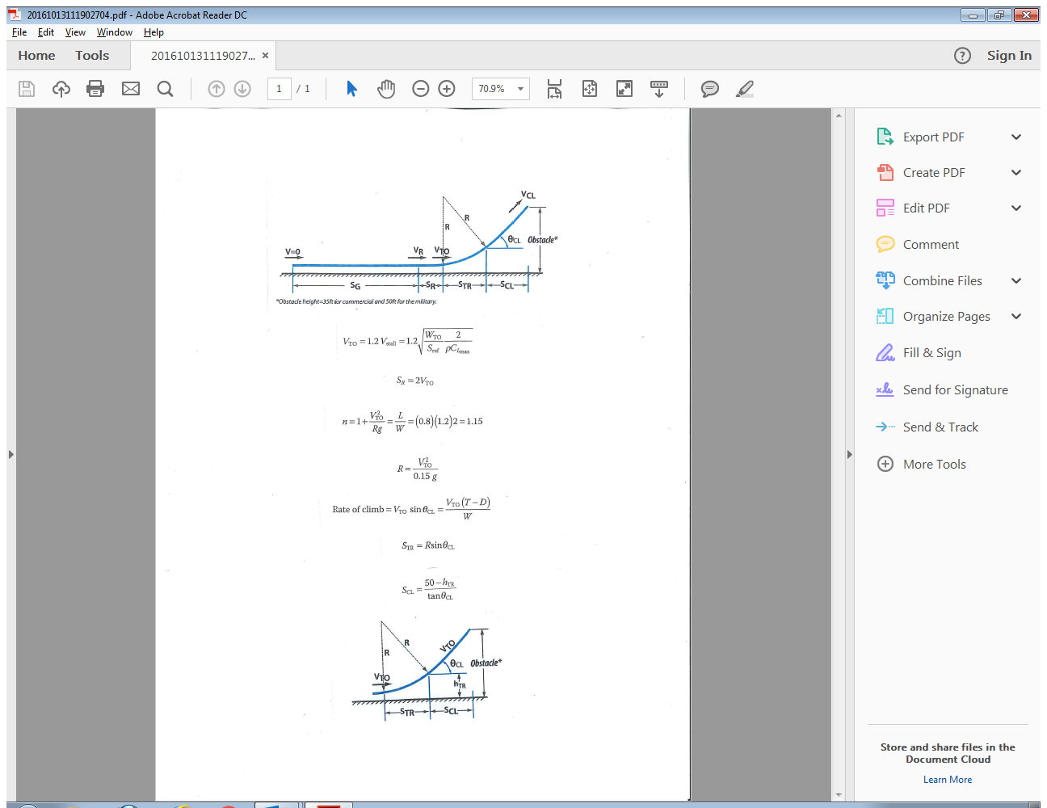
Nicolai

Slide 5
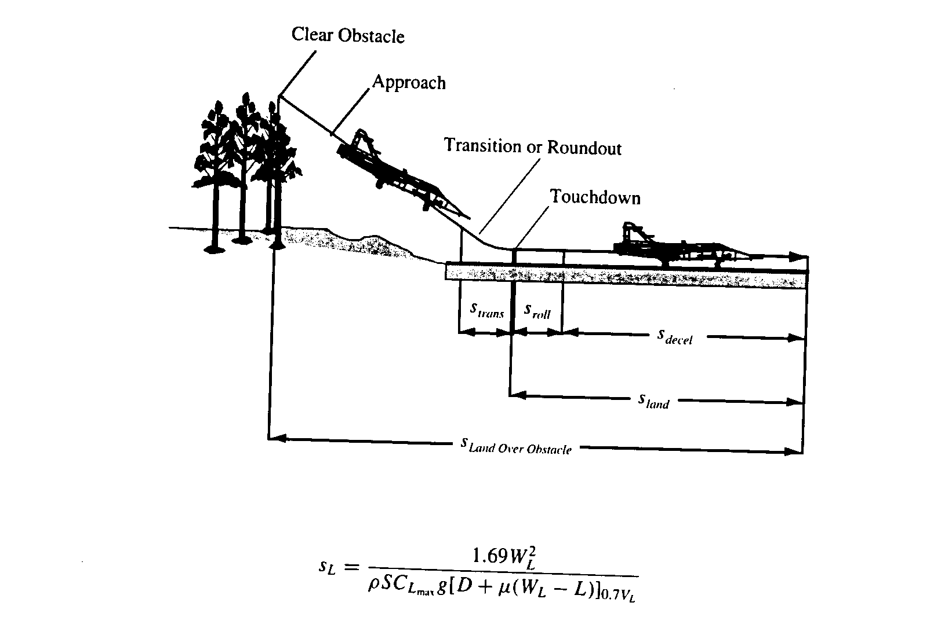
(Brandt)

Slide 6
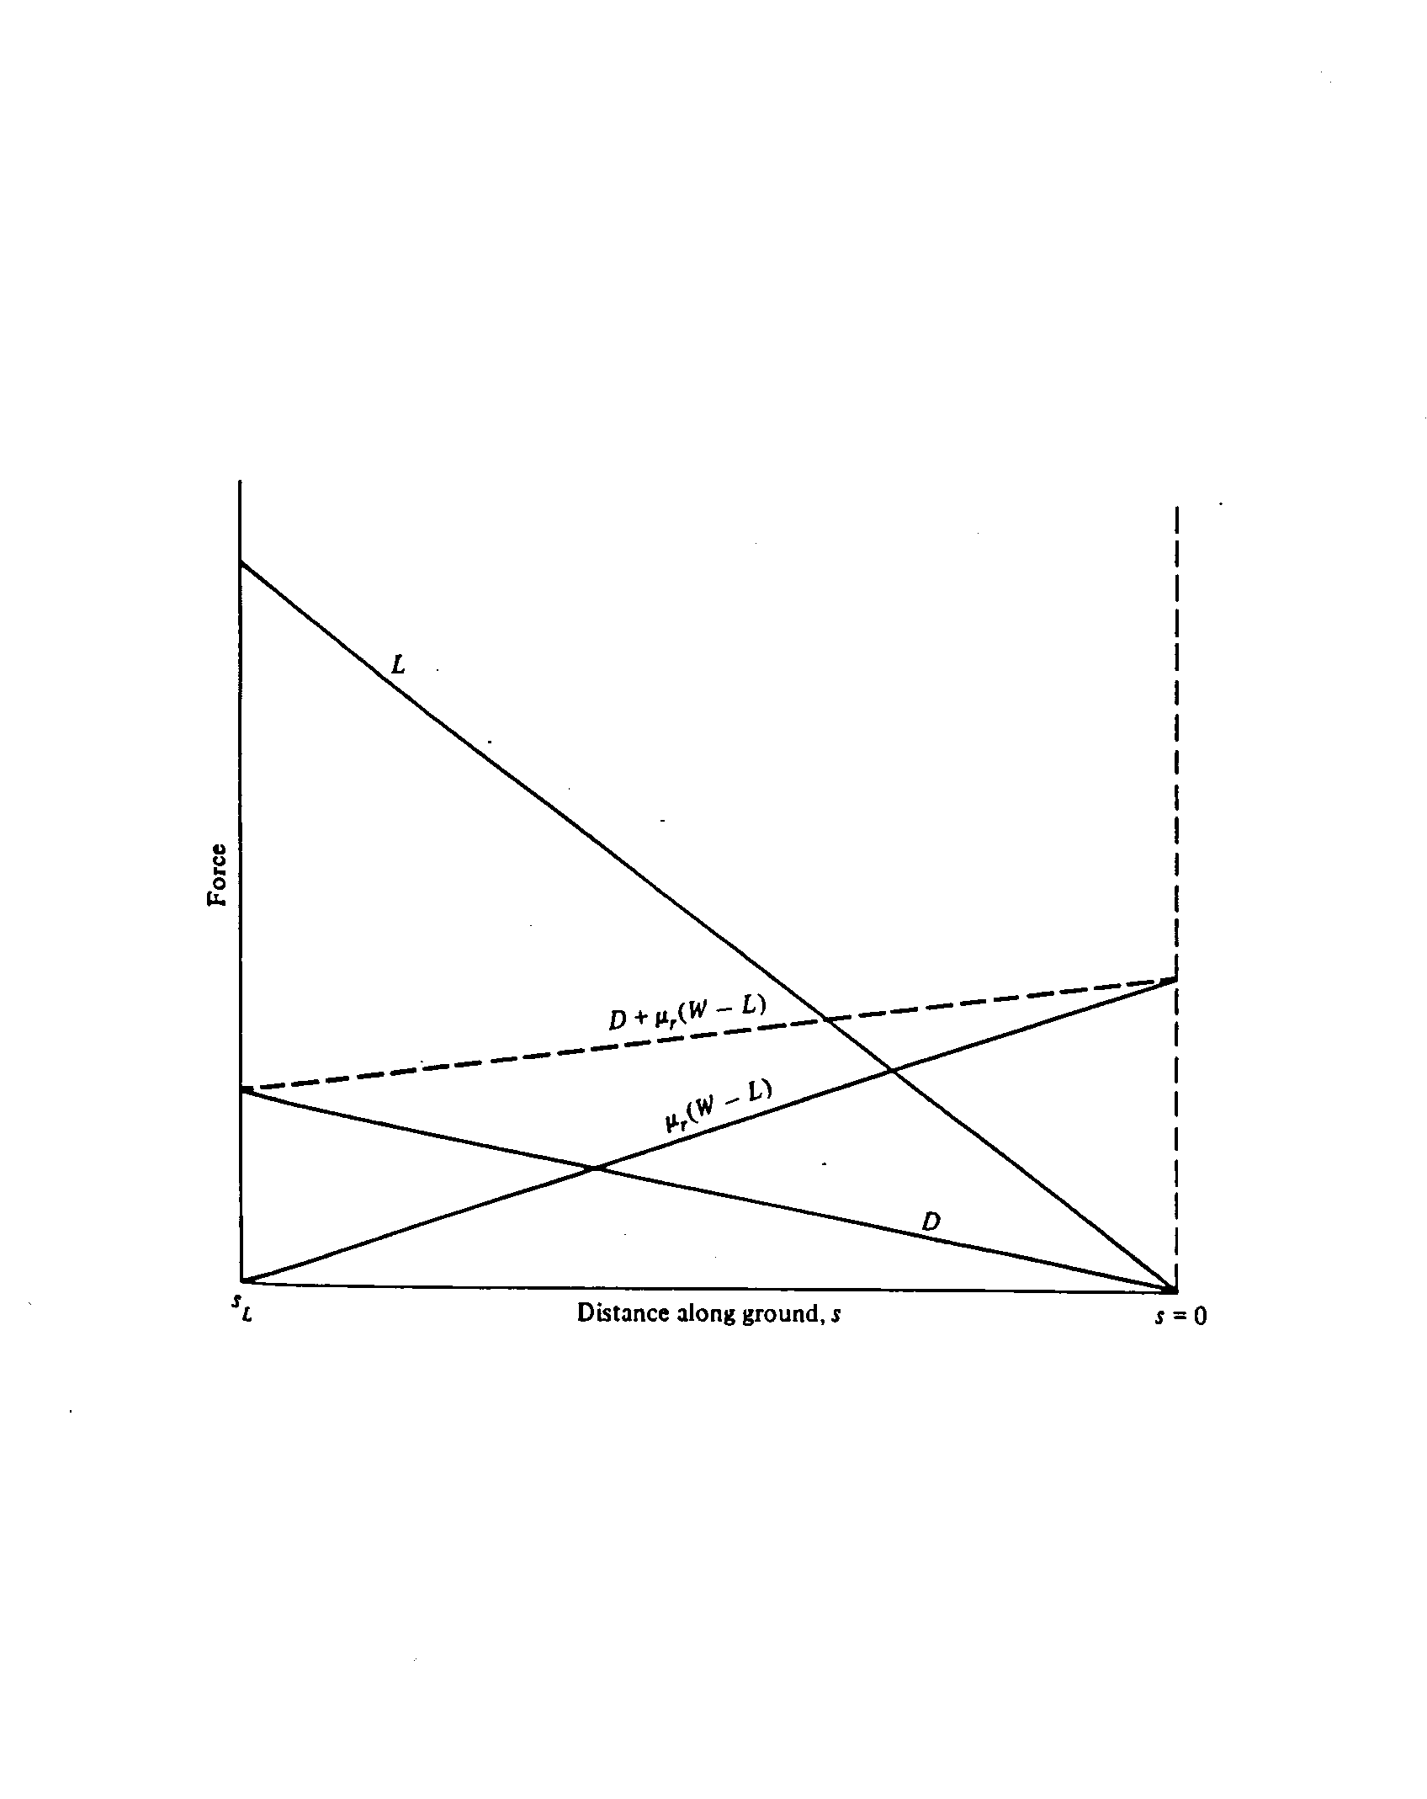
(Anderson)

Slide 7
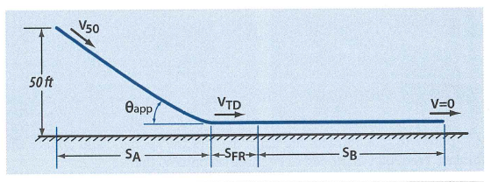
Nicolai

Slide 8
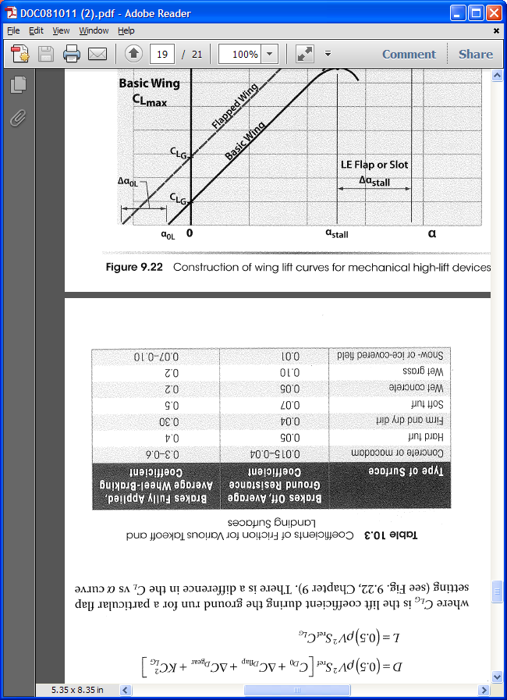
(Nicolai/Carichner)

Slide 9
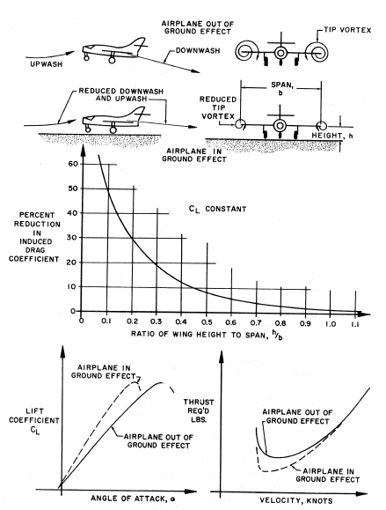
(ANA)

